Slide 1
Murach’s C# (8th Edition)
Chapter 20
How to use Entity Framework Core

Slide 2
Objectives
Applied
Create a data model from an existing database.
Use LINQ to retrieve data from one or more database tables.
Use EF Core to add, modify, and delete rows in a database table.
Bind controls to an entity collection or the results of a query.
Knowledge
Explain how EF Core works.
Describe these terms as they relate to EF Core: DB context class, entity class, navigation property, and association.
Describe how to add EF packages to a project.
Describe how to modify the code generated by EF Core.
Describe how to use eager loading and explicit loading to load related objects.

Slide 3
Objectives (continued)
Describe a concurrency conflict and distinguish between these two types of concurrency control: last-in wins and optimistic.
Describe how to use a data access class to encapsulate your EF Core code.

Slide 4
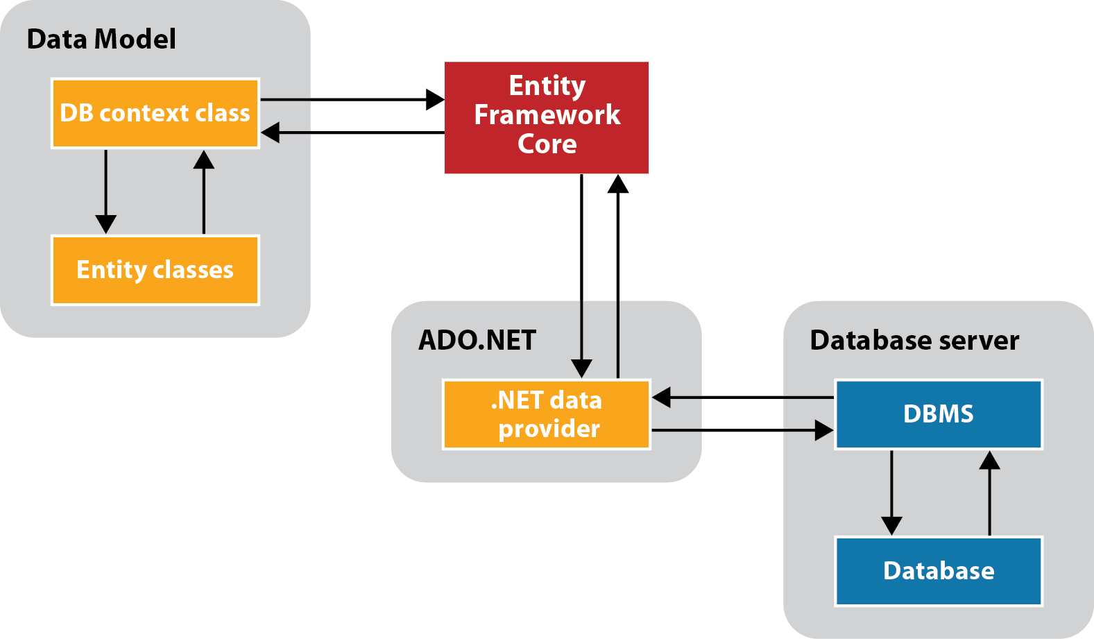
A diagram of how Entity Framework Core works

Slide 5
Entity Framework Core concepts
Entity Framework (EF) Core provides a layer between the database for an app and the objects for an app.
To provide the interface between the objects and the database, EF Core uses a DbContext class and entity classes.
When you execute a query with LINQ, EF Core translates the query and sends it to the data provider, which sends it to the database.
When the results are returned from the database, EF Core translates them to the objects defined by the entity classes.
EF Core also provides for tracking changes and submitting those changes to the database.

Slide 6
Two ways to query a database
LINQ
SQL

Slide 7
How to open the NuGet Package Manager
Select Tools→ NuGet Package Manager→ Manage NuGet Packages for Solution

Slide 8
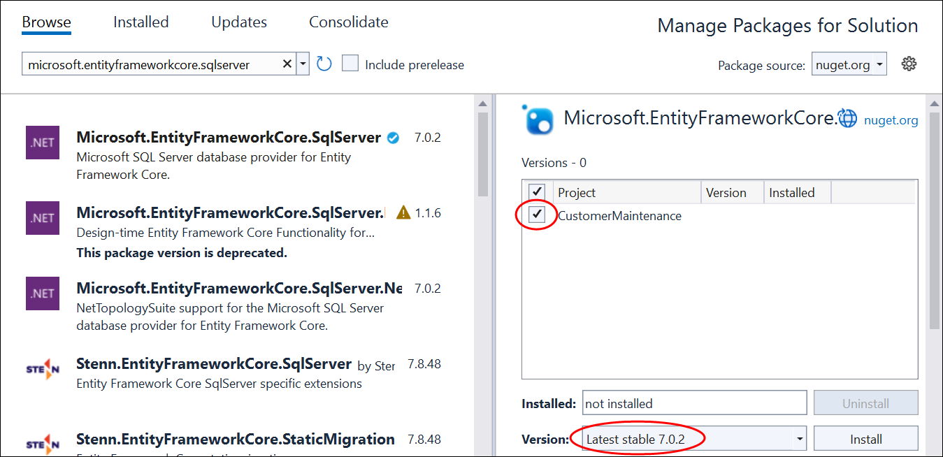
The NuGet Package Manager with the EF Core package selected

Slide 9
Parameters for the Scaffold-DbContext command
-Connection
-Provider
-OutputDir
-Context
-DataAnnotations
-UseDatabaseNames
-Force

Slide 10
Common values used in a connection string for SQL Server Express LocalDB
Data Source/Server
AttachDbFilename
Integrated Security

Slide 11
A Scaffold-DbContext command for a Sql Server Express LocalDB database
PM> Scaffold-DbContext –Connection
"Data Source=(LocalDB)\MSSQLLocalDB;
AttachDBFilename=C:\C#\Database\MMABooks.mdf;
Integrated security=True"
-Provider Microsoft.EntityFrameworkCore.SqlServer
-OutputDir Models\DataLayer -Context MMABooksContext
-DataAnnotations –Force
The same command with the flags omitted
PM> Scaffold-DbContext
"Data Source=(LocalDB)\MSSQLLocalDB;
AttachDBFilename=C:\C#\Database\MMABooks.mdf;
Integrated security=True"
Microsoft.EntityFrameworkCore.SqlServer
-OutputDir Models\DataLayer -Context MMABooksContext
-DataAnnotations –Force

Slide 12
How to generate DB context and entity classes
The DB context class is used to communicate with the database, and the entity classes represent the objects used by the app.
To generate context and entity classes from an existing database, you can use the Scaffold-DbContext command.
You enter the Scaffold-DbContext command in the NuGet Package Manager Console (PMC) window.
To display the PMC window from Visual Studio, select Tools→NuGet Package Manager→Package Manager Console.

Slide 13
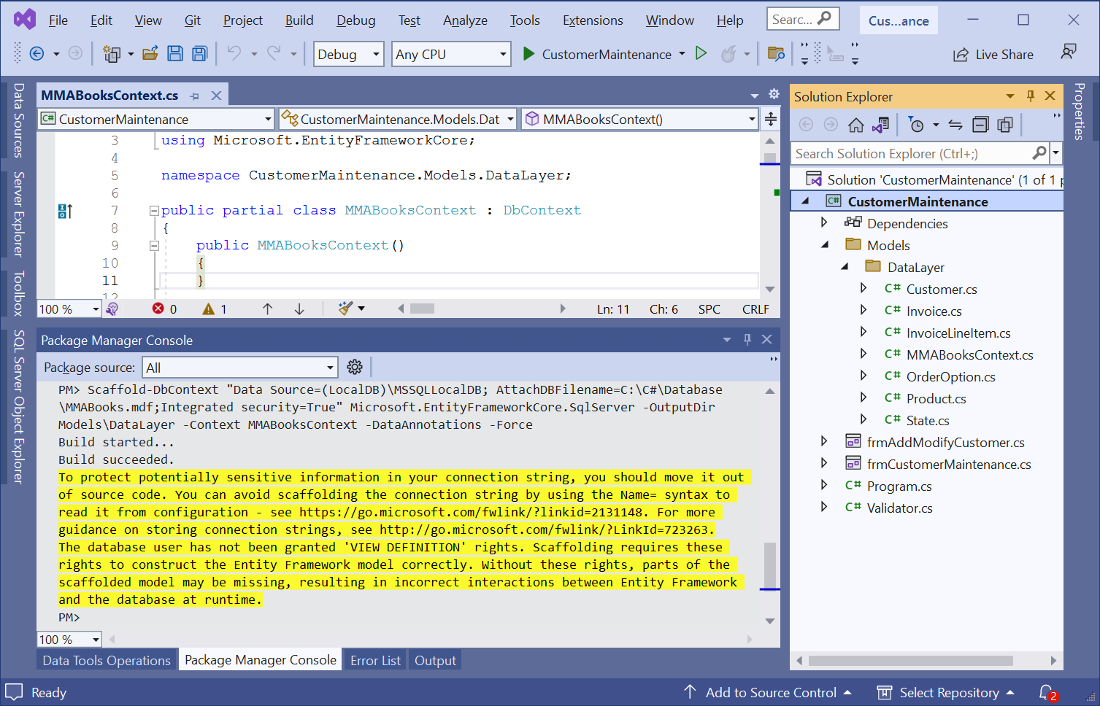
A Visual Studio project with a data model

Slide 14
The DB context class generated by the Scaffold-DbContext command (part 1)
using Microsoft.EntityFrameworkCore;
namespace CustomerMaintenance.Models.DataLayer;
public partial class MMABooksContext : DbContext
{
public MMABooksContext() {}
public MMABooksContext(
DbContextOptions<MMABooksContext> options)
: base(options) {}
public virtual DbSet<Customer> Customers {
get; set; }
public virtual DbSet<Invoice> Invoices { get; set; }
public virtual DbSet<InvoiceLineItem>
InvoiceLineItems { get; set; }
public virtual DbSet<OrderOption> OrderOptions {
get; set; }
public virtual DbSet<Product> Products { get; set; }
public virtual DbSet<State> States { get; set; }

Slide 15
The DB context class (part 2)
protected override void OnConfiguring(
DbContextOptionsBuilder optionsBuilder) =>
optionsBuilder.UseSqlServer(
"Data Source=(LocalDB)\\MSSQLLocalDB; " +
"AttachDBFilename=C:\\C#\\Database\\MMABooks.mdf;" +
"Integrated security=True");
protected override void OnModelCreating(
ModelBuilder modelBuilder) {
modelBuilder.Entity<Customer>(entity =>
{
entity.Property(e => e.State).IsFixedLength();
entity.Property(e =>
e.ZipCode).IsFixedLength();
entity.HasOne(d => d.StateNavigation)
.WithMany(p => p.Customers)
.OnDelete(DeleteBehavior.ClientSetNull)
.HasConstraintName("FK_Customers_States");
}
);

Slide 16
The DB context class (part 3)
modelBuilder.Entity<Invoice>(entity =>
{
entity.HasOne(d => d.Customer)
.WithMany(p => p.Invoices)
.HasConstraintName("FK_Invoices_Customers");
});
modelBuilder.Entity<InvoiceLineItem>(entity =>
{
entity.Property(e =>
e.ProductCode).IsFixedLength();
entity.HasOne(d => d.Invoice)
.WithMany(p => p.InvoiceLineItems)
.HasConstraintName(
"FK_InvoiceLineItems_Invoices");
entity.HasOne(d => d.ProductCodeNavigation)
.WithMany(p => p.InvoiceLineItems)
.OnDelete(DeleteBehavior.ClientSetNull)
.HasConstraintName(
"FK_InvoiceLineItems_Products");
});

Slide 17
The DB context class (part 4)
modelBuilder.Entity<Product>(entity =>
{
entity.Property(e =>
e.ProductCode).IsFixedLength();
});
modelBuilder.Entity<State>(entity =>
{
entity.Property(e =>
e.StateCode).IsFixedLength();
});
OnModelCreatingPartial(modelBuilder);
}
partial void OnModelCreatingPartial(
ModelBuilder modelBuilder);
}

Slide 18
Some of the data annotation attributes for configuration
Key
Column
Unicode
StringLength
ForeignKey
InverseProperty

Slide 19
The generated Customer partial class (part 1)
using System.ComponentModel.DataAnnotations;
using System.ComponentModel.DataAnnotations.Schema;
using Microsoft.EntityFrameworkCore;
namespace CustomerMaintenance.Models.DataLayer;
public partial class Customer
{
[Key]
[Column("CustomerID")]
public int CustomerId { get; set; }
[StringLength(100)]
[Unicode(false)]
public string Name { get; set; } = null!;
[StringLength(50)]
[Unicode(false)]
public string Address { get; set; } = null!;

Slide 20
The generated Customer partial class (part 2)
// City, State, and ZipCode properties go here
[InverseProperty("Customer")]
public virtual ICollection<Invoice> Invoices { get; } =
new List<Invoice>();
[ForeignKey("State")]
[InverseProperty("Customers")]
public virtual State StateNavigation { get; set; } =
null!;
}

Slide 21
An App.config file that includes a database connection string
<?xml version="1.0" encoding="utf-8" ?>
<configuration>
<connectionStrings>
<add name="MMABooks"
connectionString=
"Data Source=(LocalDB)\MSSQLLocalDB;
AttachDBFilename=C:\C#\Database\MMABooks.mdf;
Integrated Security=True"/>
</connectionStrings>
</configuration>

Slide 22
The updated OnConfiguring() method in the DB context file
using Microsoft.EntityFrameworkCore;
using System.Configuration;
...
protected override void OnConfiguring(
DbContextOptionsBuilder optionsBuilder)
{
if (!optionsBuilder.IsConfigured)
{
optionsBuilder.UseSqlServer(
ConfigurationManager
.ConnectionStrings["MMABooks"]
.ConnectionString);
}
}

Slide 23
A partial class that adds a read-only property
namespace CustomerMaintenance.Models.DataLayer;
public partial class Customer
{
public bool HasAddress =>
!string.IsNullOrEmpty(Address);
}

Slide 24
A statement that creates an instance of the DB context
MMABooksContext context = new();

Slide 25
A query that stores all the invoices in a variable
var invoices = context.Invoices.ToList();

Slide 26
A query that gets a single invoice by ID
var selectedInvoice = context.Invoices
.Where(i => i.InvoiceId == 33).FirstOrDefault();
Another way to get a single invoice by ID
var selectedInvoice = context.Invoices.Find(33);

Slide 27
A query that gets selected invoices
var invoices = context.Invoices
.Where(i => i.InvoiceTotal > 250)
.Select(i => new { i.CustomerId,
i.InvoiceDate,
i.InvoiceTotal })
.ToList();

Slide 28
A query that joins customer and invoice data
var customerInvoices = context.Customers
.Join(context.Invoices,
c => c.CustomerId,
i => i.CustomerId,
(c, i) => new { c.Name, i.InvoiceDate,
i.InvoiceTotal })
.OrderBy(ci => ci.Name)
.ThenByDescending(ci => ci.InvoiceTotal) .ToList();

Slide 29
A query that uses eager loading to load related entities
var selectedCustomer = context.Customers
.Include(c => c.Invoices)
.Where(c => c.CustomerId == customerID)
.Single();

Slide 30
Code that explicitly loads the entities on the many side of a relationship
var selectedCustomer = context.Customers
.Where (c => c.CustomerId == customerID)
.Single();
if (!context.Entry(selectedCustomer)
.Collection("Invoices").IsLoaded)
context.Entry(selectedCustomer)
.Collection("Invoices").Load();

Slide 31
Code that explicitly loads the entity on the one side of a relationship
var selectedInvoice = context.Invoices
.Where(i => i.InvoiceId == invoiceID)
.Single();
if (!context.Entry(selectedInvoice)
.Reference("Customer").IsLoaded)
context.Entry(selectedInvoice)
.Reference("Customer").Load();

Slide 32
Three of the methods of the DbSet class
Add(entity)
Update(entity)
Remove(entity)

Slide 33
Code that adds a new entity
var customer = new() {
Name="Nick Taggart", Address="123 Main St",
City="Fresno", State="CA", ZipCode="93650" };
context.Customers.Add(customer);

Slide 34
Code that modifies an existing entity
var customer = context.Customers.Find(1);
customer.ZipCode = "93651";
context.Customers.Update(customer); // often not needed

Slide 35
Code that marks an entity for deletion
var customer = context.Customers.Find(1);
context.Customers.Remove(customer);

Slide 36
A statement that saves the changes to the database
int rowsAffected = context.SaveChanges();

Slide 37
Code that handles database exceptions (part 1)
using Microsoft.EntityFrameworkCore;
using Microsoft.Data.SqlClient;
...
private void btnDelete_Click(object sender, EventArgs e)
{
DialogResult result =
MessageBox.Show($"Delete {selectedCustomer.Name}?",
"Confirm Delete", MessageBoxButtons.YesNo,
MessageBoxIcon.Question);
if (result == DialogResult.Yes)
{
try
{
context.Customers.Remove(selectedCustomer);
context.SaveChanges();
ClearControls();
}

Slide 38
Code that handles database exceptions (part 2)
catch (DbUpdateException ex)
{
string msg = "";
var sqlException =
(SqlException)ex.InnerException!;
foreach (SqlError error in sqlException.Errors)
{
msg += $"ERROR CODE {error.Number}:
{error.Message}\n";
}
MessageBox.Show(msg, "Database Error");
}
}
}

Slide 39
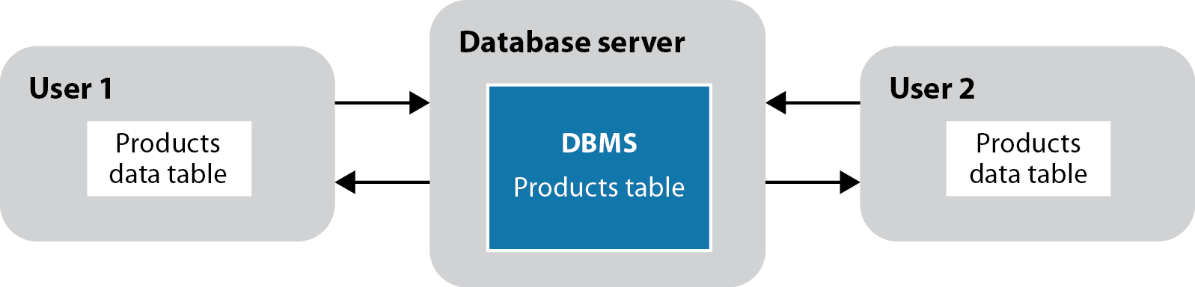
A diagram of two users who are working with copies of the same data

Slide 40
Concurrency concepts (part 1)
When two or more users retrieve the data in the same row of a database table at the same time, it is called a concurrency conflict.
Because EF Core uses a disconnected data architecture, the database management system can’t prevent conflicts.
If two users try to update the same row in a table at the same time, the second user’s changes could overwrite the first user’s changes.
Whether or not that happens, depends on the concurrency control that the programs use.
By default, EF Core uses last in wins. This means that the program doesn’t check whether a row has been changed before an update or delete operation takes place.
Last in wins can lead to errors in the database.

Slide 41
Concurrency concepts (part 2)
With optimistic concurrency, the program checks whether the database row that’s going to be updated or deleted has been changed since it was retrieved.
If the row has been changed, a concurrency exception occurs and the update or delete operation is refused. Then, the calling program should handle the exception.

Slide 42
How to avoid concurrency conflicts
Use optimistic concurrency for apps where concurrency conflicts are likely to be rare. But handle the exceptions that do occur.
Design a program so it updates the database and refreshes the entity collections frequently.
Design a program so it retrieves and updates just one row at a time.
Use pessimistic concurrency, which locks a database record while it’s being updated. Since that creates its own problems, most apps don’t use pessimistic concurrency.

Slide 43
How to configure a concurrency token with attributes
public partial class Customer {
[Key]
[Column("CustomerID")]
public int CustomerId { get; set; }
.
.
[StringLength(50)]
[Unicode(false)]
[ConcurrencyCheck]
public string Address {get; set; }
.
.
}

Slide 44
How to configure a rowversion property
public partial class Customer {
[Key]
[Column("CustomerID")]
public int CustomerId { get; set; }
.
.
public byte[] Rowversion { get; set; }
}

Slide 45
How to simulate a concurrency conflict
// get a customer from the database
var c = context.Customers.Find(1)!;
// change the address in the database
context.Database.ExecuteSqlRaw(
"UPDATE Customers " +
"SET Address = '123 Main St' " +
"WHERE CustomerId = 1");
// change the address in the entity
c.Address = "26 Duffie Drive";
// save entity to the database
context.SaveChanges();

Slide 46
A method that handles a concurrency exception (part 1)
using Microsoft.EntityFrameworkCore;
private void btnModify_Click(object sender, EventArgs e)
{ try
{
context.SaveChanges();
DisplayCustomer();
}
catch (DbUpdateConcurrencyException ex)
{
ex.Entries.Single().Reload();
if (context.Entry(customer).State ==
EntityState.Detached)
{
MessageBox.Show(
"Another user has deleted that customer.",
"Concurrency Error");
ClearControls();
}

Slide 47
A method that handles a concurrency exception (part 2)
else
{
string message =
"Another user has updated that customer.\n" +
"The current values will be displayed.";
MessageBox.Show(message, "Concurrency Error");
DisplayCustomer();
}
}
catch (DbUpdateException ex) {...}
}

Slide 48
Combo box properties for binding
DataSource
DisplayMember
ValueMember

Slide 49
Code that binds a combo box to an entity collection
cboCustomers.DataSource = context.Customers.ToList();
cboCustomers.ValueMember = "CustomerId";
cboCustomers.DisplayMember = "Name";

Slide 50
Code that binds a combo box to the results of a query
var customers = context.Customers
.OrderBy(c => c.Name)
.Select(c =>
new { c.CustomerId, c.Name });
cboCustomers.DataSource = customers.ToList();
cboCustomers.ValueMember = "CustomerId";
cboCustomers.DisplayMember = "Name";

Slide 51
How to assign the entity property names without using string literals
cboCustomers.ValueMember = nameof(Customer.CustomerId);
cboCustomers.DisplayMember = nameof(Customer.Name);

Slide 52
The MMABooksDataAccess class (part 1)
using Microsoft.EntityFrameworkCore;
namespace CustomerMaintenance.Models.DataLayer;
public class MMABooksDataAccess
{
private MMABooksContext context = new();
public Customer? FindCustomer(int customerId) =>
context.Customers
.Where(c => c.CustomerId == customerId)
.Include(c => c.StateNavigation)
.FirstOrDefault();
public List<State> GetStates() =>
context.States.OrderBy(s => s.StateName).ToList();

Slide 53
The MMABooksDataAccess class (part 2)
public void AddCustomer(Customer customer)
{
context.Customers.Add(customer);
context.SaveChanges();
}
public void UpdateCustomer(Customer customer)
{
context.SaveChanges();
}
public void RemoveCustomer(Customer customer)
{
context.Customers.Remove(customer);
context.SaveChanges();
}
}

Slide 54
A form that uses the data access class
using CustomerMaintenance.Models.DataLayer;
...
public partial class frmCustomerMaintenance : Form
{
private MMABooksDataAccess data = new();
private void btnGetCustomer_Click(object sender,
EventArgs e)
{
if (IsValidData())
{
int customerID =
Convert.ToInt32(txtCustomerID.Text);
var selectedCustomer =
data.FindCustomer(customerID);
DisplayCustomer();
}
}
...
}

Slide 55
The MMABooksDataAccess class updated to handle database exceptions (part 1)
using Microsoft.Data.SqlClient;
using Microsoft.EntityFrameworkCore;
namespace CustomerMaintenance.Models.DataLayer;
public class MMABooksDataAccess
{ private MMABooksContext context = new();
public Customer? FindCustomer(int customerId) {
try {
context.Customers
.Where(c => c.CustomerId == customerId)
.Include(c => c.StateNavigation)
.FirstOrDefault();
return customer;
}
catch (SqlException ex) {
throw CreateDataAccessException(ex);
}
}

Slide 56
The updated MMABooksDataAccess class (part 2)
public void UpdateCustomer(Customer customer)
{
try {
context.SaveChanges();
}
catch (DbUpdateConcurrencyException ex) {
ex.Entries.Single().Reload();
var state = context.Entry(customer).State;
throw CreateConcurrencyException(state);
}
catch (DbUpdateException ex) {
throw CreateUpdateException(ex);
}
catch (SqlException ex) {
throw CreateDataAccessException(ex);
}
}

Slide 57
The updated MMABooksDataAccess class (part 3)
// RemoveCustomer() method with exception handling
private DataAccessException CreateConcurrencyException(
EntityState state)
{
string msg = "";
if (state == EntityState.Detached)
msg = "Another user has deleted that record.";
else
msg = "Another user has updated that record.\n" +
"The current database values will be displayed.";
return new DataAccessException( msg, "Concurrency Error");
}

Slide 58
The updated MMABooksDataAccess class (part 4)
private DataAccessException CreateUpdateException(
UpdateException ex)
{
var sqlException =
(SqlException)ex.InnerException!;
return CreateDataAccessException(sqlException);
}
private DataAccessException CreateDataAccessException(
SqlException ex)
{
string msg = "";
foreach (SqlError error in ex.Errors) {
msg += $"ERROR CODE {error.Number}:
{error.Message}\n";
}
return new DataAccessException(
msg, "Database Error");
}
}

Slide 59
The DataAccessException class
namespace CustomerMaintenance.Models.DataLayer;
public class DataAccessException : Exception
{
public DataAccessException(string msg, string type) :
base(msg) =>
ErrorType = type;
public string ErrorType { get; init; }
public bool IsConcurrencyError =>
ErrorType.ToLower().Contains("concurrency");
public bool IsDeleted =>
Message.ToLower().Contains("deleted");
}

Slide 60
A method that handles an exception thrown by the data access class
private void btnModify_Click(object sender, EventArgs e)
{
// code that gets an updated Customer object
try {
data.UpdateCustomer(selectedCustomer);
DisplayCustomer();
}
catch (DataAccessException ex) {
if (ex.IsConcurrencyError)
{
if (ex.IsDeleted)
ClearControls();
else
DisplayCustomer();
}
MessageBox.Show(ex.Message, ex.ErrorType);
}
}

Slide 61
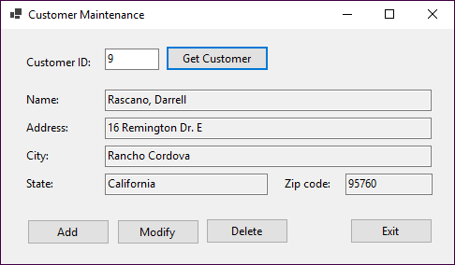
The Customer Maintenance form

Slide 62
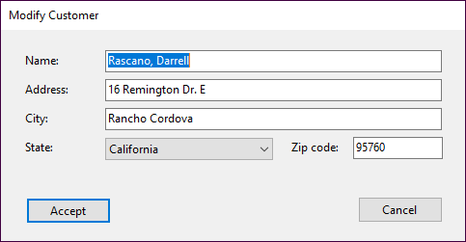
The Add/Modify Customer form

Slide 63
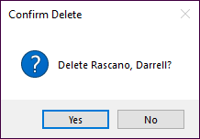
The dialog for confirming a delete operation

Slide 64
Code for the Customer Maintenance form (part 1)
public partial class frmCustomerMaintenance : Form
{
public frmCustomerMaintenance()
{
InitializeComponent();
}
private MMABooksDataAccess data = new();
private Customer selectedCustomer = null!;

Slide 65
Code for the Customer Maintenance form (part 2)
private void btnGetCustomer_Click(
object sender, EventArgs e)
{
if (IsValidData())
{
int customerID =
Convert.ToInt32(txtCustomerID.Text);
try {
selectedCustomer =
data.FindCustomer(customerID)!;
if (selectedCustomer == null)
{
MessageBox.Show(
"No customer found with this ID. " +
"Please try again.", "Not Found");
ClearControls();
}

Slide 66
Code for the Customer Maintenance form (part 3)
else
{
DisplayCustomer();
}
}
catch (DataAccessException ex) {
HandleDataAccessException(ex);
}
}
}

Slide 67
Code for the Customer Maintenance form (part 4)
private bool IsValidData()
{
bool success = true;
string errorMessage = "";
errorMessage = Validator.IsInt32(
txtCustomerID.Text, "CustomerID");
if (errorMessage != "")
{
success = false;
MessageBox.Show(errorMessage, "Entry Error");
txtCustomerID.Focus();
}
return success;
}

Slide 68
Code for the Customer Maintenance form (part 5)
private void ClearControls()
{
txtCustomerID.Text = "";
txtName.Text = "";
txtAddress.Text = "";
txtCity.Text = "";
txtState.Text = "";
txtZipCode.Text = "";
btnModify.Enabled = false;
btnDelete.Enabled = false;
txtCustomerID.Focus();
}

Slide 69
Code for the Customer Maintenance form (part 6)
private void DisplayCustomer()
{
txtCustomerID.Text =
selectedCustomer.CustomerId.ToString();
txtName.Text = selectedCustomer.Name;
txtAddress.Text = selectedCustomer.Address;
txtCity.Text = selectedCustomer.City;
txtState.Text =
selectedCustomer.StateNavigation.StateName;
txtZipCode.Text = selectedCustomer.ZipCode;
btnModify.Enabled = true;
btnDelete.Enabled = true;
}

Slide 70
Code for the Customer Maintenance form (part 7)
private void HandleDataAccessException(
DataAccessException ex)
{
if (ex.IsConcurrencyError)
{
if (ex.IsDeleted)
ClearControls();
else
DisplayCustomer();
}
MessageBox.Show(ex.Message, ex.ErrorType);
}

Slide 71
Code for the Customer Maintenance form (part 8)
private void btnAdd_Click(object sender, EventArgs e)
{
frmAddModifyCustomer addModifyForm = new() {
States = data.GetStates()
};
DialogResult result = addModifyForm.ShowDialog();
if (result == DialogResult.OK)
{
selectedCustomer = addModifyForm.Customer;
try
{
data.AddCustomer(selectedCustomer);
DisplayCustomer();
}
catch (DataAccessException ex)
{
HandleDataAccessException(ex);
}
}
}

Slide 72
Code for the Customer Maintenance form (part 9)
private void btnModify_Click(object sender,
EventArgs e)
{
frmAddModifyCustomer addModifyForm = new() {
Customer = selectedCustomer,
States = data.GetStates()
};
DialogResult result = addModifyForm.ShowDialog();
if (result == DialogResult.OK)
{
selectedCustomer = addModifyForm.Customer;
try {
data.UpdateCustomer(selectedCustomer);
DisplayCustomer();
}
catch (DataAccessException ex) {
HandleDataAccessException(ex);
}
}
}

Slide 73
Code for the Customer Maintenance form (part 10)
private void btnDelete_Click(object sender,
EventArgs e)
{
DialogResult result =
MessageBox.Show(
$"Delete {selectedCustomer.Name}?",
"Confirm Delete", MessageBoxButtons.YesNo,
MessageBoxIcon.Question);
if (result == DialogResult.Yes)
{
try {
data.RemoveCustomer(selectedCustomer);
ClearControls();
}
catch (DataAccessException ex) {
HandleDataAccessException(ex);
}
}
}

Slide 74
Code for the Customer Maintenance form (part 11)
private void btnExit_Click(object sender, EventArgs e)
{
this.Close();
}
}

Slide 75
Code for the Add/Modify Customer form (part 1)
using CustomerMaintenance.Models.DataLayer;
namespace CustomerMaintenance;
public partial class frmAddModifyCustomer : Form
{
public frmAddModifyCustomer()
{
InitializeComponent();
}
public Customer Customer { get; set; } = null!;
public List<State> States { get; set; } = null!;

Slide 76
Code for the Add/Modify Customer form (part 2)
private void frmAddModifyCustomer_Load(
object sender, EventArgs e)
{
LoadStatesComboBox();
if (Customer == null)
{
Text = "Add Customer";
cboStates.SelectedIndex = -1;
Customer = new();
}
else
{
Text = "Modify Customer";
DisplayCustomerData();
}
}

Slide 77
Code for the Add/Modify Customer form (part 3)
private void LoadStatesComboBox()
{
cboStates.DataSource = States;
cboStates.DisplayMember = nameof(State.StateName);
cboStates.ValueMember = nameof(State.StateCode);
}
private void DisplayCustomerData()
{
txtName.Text = Customer.Name;
txtAddress.Text = Customer.Address;
txtCity.Text = Customer.City;
cboStates.SelectedValue = Customer.State;
txtZipCode.Text = Customer.ZipCode;
}

Slide 78
Code for the Add/Modify Customer form (part 4)
private void btnAccept_Click(object sender,
EventArgs e)
{
if (IsValidData())
{
LoadCustomerData();
DialogResult = DialogResult.OK;
}
}

Slide 79
Code for the Add/Modify Customer form (part 5)
private bool IsValidData() {
bool success = true;
string errorMessage = "";
errorMessage +=
Validator.IsPresent(txtName.Text, "Name");
errorMessage += Validator.IsPresent(
txtAddress.Text, Address");
errorMessage += Validator.IsPresent(
txtCity.Text, "City");
errorMessage += Validator.IsPresent(
cboStates.Text, "State");
errorMessage += Validator.IsPresent(
txtZipCode.Text, "Zip Code");
if (errorMessage != "")
{
success = false;
MessageBox.Show(errorMessage, "Entry Error");
}
return success;
}

Slide 80
Code for the Add/Modify Customer form (part 6)
private void LoadCustomerData()
{
Customer.Name = txtName.Text;
Customer.Address = txtAddress.Text;
Customer.City = txtCity.Text;
Customer.State =
cboStates.SelectedValue?.ToString() ?? "";
Customer.ZipCode = txtZipCode.Text;
}
private void btnCancel_Click(
object sender, EventArgs e)
{
this.Close();
}
}

